Slide 1
Universal Human Values and Professional Ethics
VALUE EDUCATION CELL (VE CELL)
(CS/IT BLOCK 4TH FLOOR CS – 403)

Slide 2
Contents: Need of the Course
Today State - At the level of the individual
Rising problems of depression
Relative confidence
Psychological disorders
Suicides
Stress
Insecurity
Psychosomatic diseases
Loneliness etc.

Slide 3
Contents: Need of the Course
Today State - At the level of the Family
Breaking of joint families
Mistrust
Conflict between older and younger generations
Insecurity in relationships
Divorce
Dowry tortures
Family feuds
Wasteful expenditure in family functions etc.

Slide 4
Contents: Need of the Course
Today State - At the level of the Society
Growing incidences of terrorism and naxalism
Rising communalism
Spreading casteism
Racial and ethnic struggle
Wars between nations
Attempts of genocide
Fear of nuclear and genetic warfare, etc.

Slide 5
Contents: Need of the Course
Today State - At the level of the Nature
Global warming
Water, air, soil, noise, etc. pollution
Resource depletion of minerals and mineral oils
Sizeable deforestations
Loss of fertility of soil.

Slide 6
Contents: Need of the Course
Outcome of the Course (if you understand properly)
Clarity regarding a fulfilling life and the program to achieve it.
(resulting in channelized thoughts)
Harmony in Individual
(Resulting in happiness and a feeling of prosperity and living with absolute confidence)
Harmony in Family
(Resulting in mutual fulfillment in relationship and prosperity in family)
Harmony in Society
(Resulting in trustful, undivided, universal society )
Harmony in Nature/Existence
(Understanding the inherent co-existence resulting in being in harmony in Nature)

Slide 7
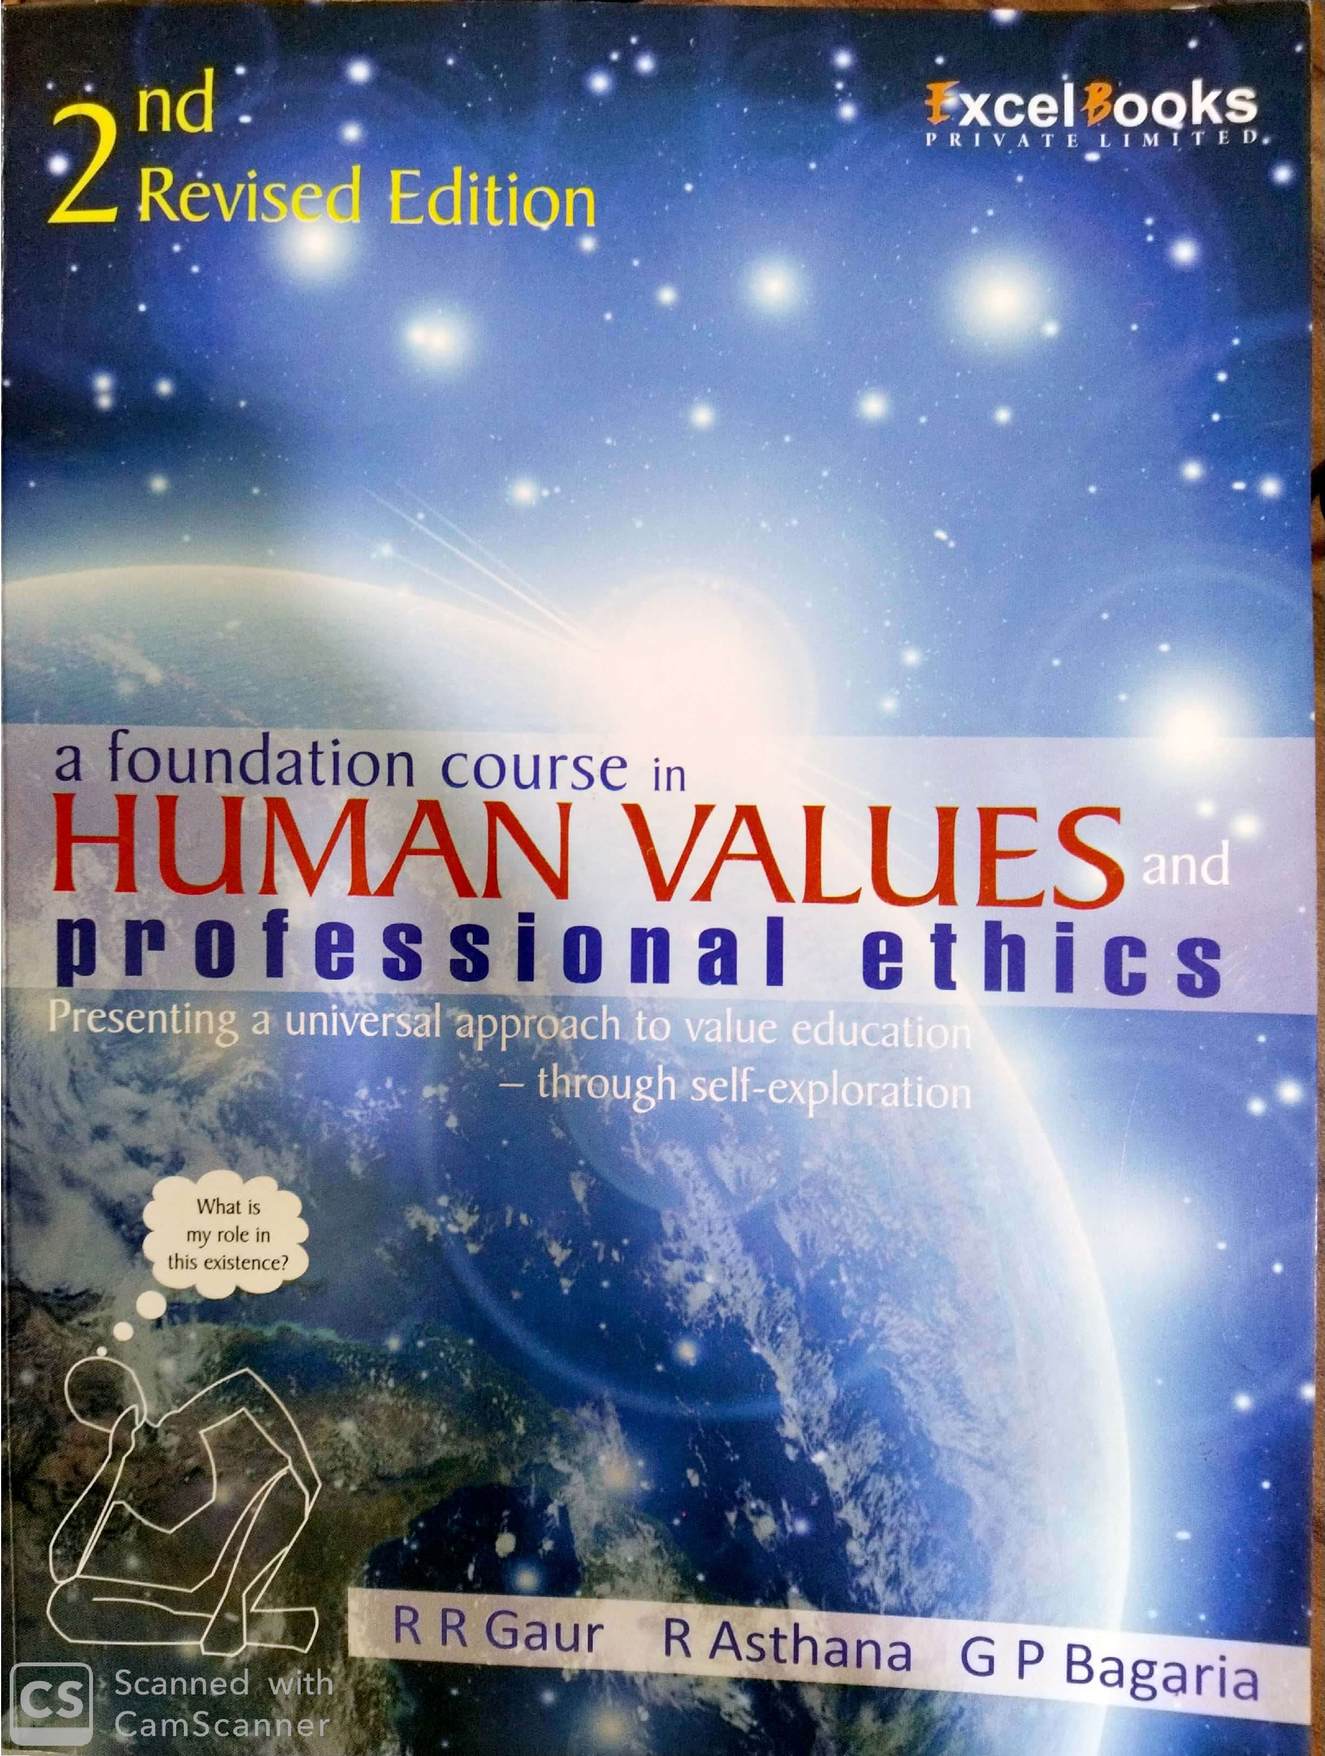
Contents: About Book

Slide 8
Contents: About Authors
Prof. R R Gaur
Prof. R R Gaur has been a senior professor of Mechanical Engineering at IIT Delhi with research focus on renewable energy conversion systems. He has also been the Head of National Resource Centre for Value Education in Engineering at IIT Delhi and has contributed significantly towards integrating Science, Technology and Human Values through curricular development and research. For more than two decades, Prof. Gaur, along with other colleagues at IIT Delhi and other institutions has been seriously experimenting with a variety of innovative inputs in value education. He has recently taken voluntary retirement from IIT Delhi in order to fully devote himself to value education activities.

Slide 9
Contents: About Authors
Rajul Asthana
Rajul Asthana, an alumnus of IIT Delhi, has 28 years of corporate experience in India and USA. He was the IT leader of (CIO) of the Industrial Products Division of W.L Gore and Associates, USA and, later, Senior Vice President with Satyam Computer Services, Hyderabad. As head of their Learning Center globally, he was responsible for co-developing and implementing the company’s learning strategy for associate development. He was a founding member of Global Council of Corporate Universities, France promoting the idea that corporate universities can be instrumental in personal transformation. He was also the founder director of The International Resource Center for Universal Human Values and Ethics at Punjab Technical University, Jalandhar.

Slide 10
Contents: About Authors
Prof. G P Bagaria
Highly respected teacher both in Electronics and Communication as well as in Value Education. He has carried out extensive research over the past 15 years in evolving a suitable methodology for Value Education and has successfully experimented with it, both within the institutional framework as well as with a variety of people in the community at large. He is accepted as an inspiring role model by his students and peers. For the work carried out by him in the area of Value Education and as social activist, he was awarded the Satyendra K Dubey Memorial Award for the year 2006 by IIT Kanpur. He is an alumnus of IIT Kanpur.

Slide 11
Word, Meaning and Reality
Once you self-explore and see a reality, you know much more about it than any description that can be given. You may be able to describe many more details
The reality is not the words. Try describing everything about yourself! Any reality is beyond words
You do see through your senses, but you have the capacity to see beyond that (through the Self, by self-exploration)
Every human being has the need and also the potential to see the entire reality
We will use words like ‘happiness’, ‘trust’, ‘respect’, ‘harmony’…
So, please try to get to the reality being described, rather than getting stuck to the words being used.

Slide 12
Important Points
Avoid jumps to readymade solutions.
Avoid comparing with existing beliefs/ notions.
2 Step process :
Verify the proposals (rather than agreeing or disagreeing)
Experimentally validate the proposals

Slide 13
Methodology:
Whatever is stated is a Proposal (Do not assume it to be true)
Verify it on your own right
2
1
Verify
on the basis
Of
your
Natural
Acceptance
Proposal
Experiential Validation
Live according to it
2a
2b
Behaviour with
Human Beings
Work with
Rest of Nature
Mutual Happiness
Mutual Prosperity
Which process is Naturally Acceptable to you?
A process of self-exploration on your own right, leading to understanding in your self
or
A process of discourse, do’s & don’ts, in which you assume what is said

Slide 14
Conents: Guidelines for Value Education
Universal – all time, all place, all individuals. Not sectarian. E.g. Respect
Rational – logical, appeals to human reasoning. It must be possible to discuss & ask questions. Not do’s & don’ts
3. Natural – Naturally Acceptable to human being
(there is provision in Nature for its fulfilment)
4. Verifiable – through one’s own Natural Acceptance as well as
in one’s experience.
5. All Encompassing – covering all aspects of life, of human existence
6. Leading to
Harmony in living – among human beings and with nature.

Slide 15
Contents: Scope of the Subject
Fulfilling Life
Nature/Existence
Society
Family
Individual

Slide 16
Thank You
VALUE EDUCATION CELL (VE CELL)
(CS/IT BLOCK 4TH FLOOR CS – 403)

Slide 17
1. Understanding the Need and Basic Guidelines for Value Education

Slide 18
Purpose of Value Education
To Ensure a fulfilling life.
Meaning of fulfilling life:
There is a feeling of happiness within you, all the time.
Your body is in good health.
You are able to have what you require in terms of physical facility and you have a feeling of prosperity, all the time
You have good relations with everyone connected to you.
There is peace and harmony in the society around you.
You are able to co-exist with the nature and make effort for an environment in which there is no pollution or depletion of resources, and
You are able to understand the main aspects of your own reality as well as the rest of existence as it is.
To Ensure the above fulfilling life, proper education is required.

Slide 19
Education for a fulfilling life
To understand what a fulfilling life means and to understand the programme to ensure it, there is need for appropriate education.
On this earth it is only the human being which goes through a long process of education, yet, it is the human being only who is creating so many problems on this planet. (not mutually fulfilling)
As a human being, we have two important questions to resolve:
What to do? (Value Education)
Gives us the clarity of our goal, our basic aspiration and the programme to fulfill the basic aspiration
How to do it? ( Skill Education)
It helps us learn skills, methods and techniques to implement the programme.

Slide 20
Education for a Fulfilling Life
Value Education:
The value of an entity is its participation in the larger order of which it is a part.
For example:
The value of a pen is that it can write. Here writing is the participation of the pen in the bigger order in which it is present along with paper and human being.
The value of an eye is that it can be used for seeing.
The value of a vegetable plant is that it provides nutrition to animals and humans.
WHAT IS THE VALUE OF A HUMAN BEING?

Slide 21
THE VALUE OF A HUMAN BEING
The value of a human being is its natural or expected participation in the larger order –
At the level of the individual
At the level of family
At the level of society
At the level of nature/existence.
It is interesting to note that you feel happy in the process of fulfilling your participation in the larger order.

Slide 22
Value Education
The part of education that deals with the understanding of one’s participation in the larger order, and thus ensuring it in living, is called as Value Education.

Slide 23
Skill Education
Skill Education
Skills are necessary in our life. (computer, telecom, construction..)
However, along with skills, it is essential to decide the purpose for which they are to be used.
Complementarity of Values and Skills.
Right utilization of learnt skills.
Achieving right purpose.
Priority of Values over Skill
What is more important: What to do? OR How to do?

Slide 24
Need and Important Implications of Value Education
Correct identification of our aspirations.
Develop a Holistic Perspective
Clarity of Programme to Live with Holistic Perspective.
Evaluation of our beliefs
Solution of existing problems
Technology and Human Values
Development of Ethical Competence

Slide 25
Guidelines for Value Education
Universal – all time, all place, all individuals. Not sectarian. E.g. Respect
Rational – logical, appeals to human reasoning. It must be possible to discuss & ask questions. Not do’s & don’ts
3. Natural – Naturally Acceptable to human being & Natural
(there is provision in Nature for its fulfilment)
4. Verifiable – through one’s own Natural Acceptance as well as
in one’s experience. Not mystical
5. All Encompassing – covering all aspects of life, of human existence
6. Leading to
Harmony in living – among human beings and with nature.

Slide 26
Content of Value Education
All Dimensions:
Thought, Behaviour, work and realization.
All levels of human living:
individual, family, society, nature/existence of human living.

Slide 27
Process of Value Education
Whatever is stated is a Proposal (Do not assume it to be true)
Verify it on your own right
Proposal
1
2
Verify
on the basis
Of
your
Natural
Acceptance
Experiential Validation
Live according to it
2a
2b
Behaviour with
Human Beings
Work with
Rest of Nature
Mutual Happiness
Mutual Prosperity
Which process is Naturally Acceptable to you?
A process of self-exploration on your own right, leading to understanding in your self
or
A process of discourse, do’s & don’ts, in which you assume what is said

Slide 28
2. Self-Exploration as the Process for Value Education

Slide 29
Self-Exploration, Self-investigation
It is a process of seeing the truth about a reality on our own right, by our own investigation, observation and analysis.
It is the first step in verification of a proposal.
It is a process of dialogue that starts between us and you, then it turns into a dialog within your own self.
Dialogue within
What is naturally acceptable to me
What I am ?

Slide 30
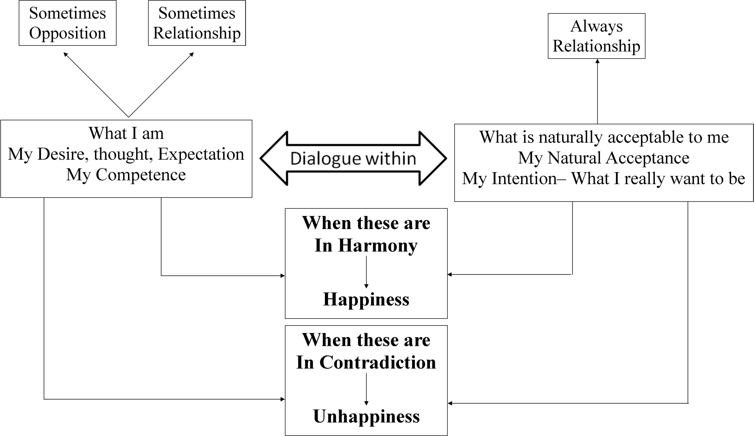
What I am and What I really want to be

Slide 31
Self-Exploration, Self-investigation
1. Content of Self Exploration:
a. Desire - Aim, Objective, Purpose- Basic Aspiration
What do I want to achieve?
b. Program – Process of achieving the desire, action
How do I achieve it ?
2. Process of Self Exploration
a. Whatever is stated is a Proposal (Do not assume it to be true)
Verify it on your own
Self-verification

Slide 32
Process of Self-exploration
Whatever is stated is a Proposal (Do not assume it to be true)
Verify it on your own right
Proposal
1
2
Verify
on the basis
Of
your
Natural
Acceptance
Experiential Validation
Live according to it
2a
2b
Behaviour with
Human Beings
Work with
Rest of Nature
Mutual Happiness
Mutual Prosperity
Which process is Naturally Acceptable to you?
A process of self-exploration on your own right, leading to understanding in your self
or
A process of discourse, do’s & don’ts, in which you assume what is said

Slide 33
Understanding Natural Acceptance
What is Naturally acceptable to you?-
You want to be Happy or Unhappy?
Where does the answer come from?
Is it coming from your likes, dislikes, assumptions, preconditionings, beliefs, world-view, perspective etc.
OR
Is it coming from your Natural Acceptance

Slide 34
Characteristics of Natural Acceptance
It does not change with time.
It does not change with place.
It doesn’t change with the individual. It is the same for all of us: it is a part and parcel of every human being.
It does not depend on our likes, dislikes, beliefs or past conditioning.
It is innate (constantly there), we don’t need to create it.
Natural Acceptance is definite.

Slide 35
What is the self-exploration
1. It is a process of dialogue – between me and you, to begin with
2. It soon becomes a dialog within your own Self…
What I am What is Naturally Acceptable to Me
Desire, Thought, Natural Acceptance
Expectation…
Harmony
Contradiction
Dialog

Slide 36
Self-exploration, Self-investigation – Within My Self
What I am What is Naturally Acceptable
Desire, Thought… Natural Acceptance
Harmony → Happiness → Swatantrata
Contradiction → Unhappiness → Partantrata
Dialog
Happiness = To be in a state of Harmony
Unhappiness = To be forced to be in a state of Contradiction

Slide 37
Self-exploration
B1 – Dimension of Realisation
B2 – Dimension of Thought
Behaviour Work & Participation
Mutual Happiness Mutual Prosperity
Mutual Fulfillment Mutual Enrichment
2. Verify the Proposal
on the basis of your Natural Acceptance
1. Proposal
from outside
3. Experiential verification
by living accordingly

Slide 38
Process of Self-exploration, Self-investigation
It is a process of dialogue – between me and you, to begin with. It soon becomes a dialogue within your own self
It is a process of dialog between what I am and my Natural Acceptance or what I really want to be
It is a process of Self-exploration, Self-investigation → Self-evolution
It is a process of knowing oneself and through the self, knowing Nature and the entire existence
It is a process of recognizing one's relationship with every unit in nature/existence; and fulfilling that relationship
It is a process of knowing Human Conduct and living according to it
It is a process of living in harmony in oneself, living in harmony with others…living in harmony with entire existence

Slide 39
Scope of this Content
Knowing your Natural Acceptance
What you really want to be
(Natural Acceptance)
Living in accordance with your Natural Acceptance
Living in harmony within
(Self-organized)
Living in harmony with others… with the entire existence
(Self-Expression)
Everything is in Harmony= Universal Human Order

Slide 40
Desire – Aim, Objective, Purpose
Desire – Aim, Objective, Purpose
To Become To Do/Get To Be
Doctor Service, Money, Respect… Happy & Prosperous
Engineer Make Things, Money, Respect … Happy & Prosperous
IIT Engineer Make Things, Money++, Respect++… Happy & Prosperous
Mother Take Care, Trust, Respect, Guidance… Happy & Prosperous
Farmer Grow Things, Money, Respect… Happy & Prosperous
Thief Get Things, Money, Respect… Happy & Prosperous
…..
Steps toward Goal Basic Human Goal
Not the Goal Desire, Aim, Objective, Purpose

Slide 41
3. Basic Human Aspirations and their Fulfilment

Slide 42
What is meant by Basic Aspiration
Education Cycle:
School
College
Assignments/
Grades
Placement
Out of these which is our basic aspiration?
What if one of these gets fulfilled?
Is there any end state where we want to reach and then we want continuity of that state?
To explore the question of basic aspiration, Some questions need to be asked to yourself

Slide 43
Desire State of Being
Do we want to be happy?
Do we want to be prosperous?
Do we want the continuity of happiness and prosperity?
Are we happy?
Are we prosperous?
Is there continuity of our happiness and prosperity?

Slide 44
Effort
Is our effort
For continuity of happiness and prosperity?
Just for accumulation of physical facility?
Have you assumed that happiness and prosperity will automatically come when you have enough physical facility?
What effort are you making for continuity of happiness and prosperity, other than accumulation of physical facility?

Slide 45
Check within Yourself!
The unhappiness in your family is
More due to lack of physical facility or
More due to lack of fulfillment in relationship?
How much time and effort are you investing:
For physical facility
For fulfillment in relationship
The unhappiness is more due to lack of fulfillment in relationship
Most of the time and effort is spent for physical facility

Slide 46
Check within Yourself!
For human beings physical facility is necessary but relationship is also necessary
On examining carefully, we find that this is a fundamental difference between animals and human beings
Physical facility is necessary for animals and necessary for human beings also
However,
For animals physical facility is necessary as well as adequate
For human beings physical facility is necessary but not adequate

Slide 47
When an animal has lack of physical facility it becomes uncomfortable, when it gets physical facility it becomes comfortable
Eg. When a cow gets a stomach-full of grass, it becomes comfortable, sits and chews it.
When a human being has lack of physical facility, he becomes uncomfortable and unhappy
But once he gets the physical facility, he forgets about it and starts thinking about hundred other things
(Check for yourself if you feel happy every day that you are getting enough to eat?)

Slide 48
Other than physical facility what else does a human being think about?
On close examination, the list of thoughts can be classified into two categories:
Feelings in relationship with other human beings
Right understanding in the self, or knowledge
Human beings think about ensuring these, in addition to physical facility

Slide 49
If we recognize human beings’ aspiration, we find that they want to live in relationship with all and feel happy living in relationship, therefore relationship is necessary for human beings
Examine within yourself if
You want to live in relationship (harmony) with others or
You want to live in opposition with others or
You believe living has to be necessarily in opposition with others, ie. There is 'struggle for survival' , ‘survival of the fittest’ and check if you feel happy living this way?
Thus: for human beings, both physical facility and relationship are necessary

Slide 50
On further examination, we find that we all do want to live in relationship with others
Every night when there is a fight, we want to resolve it. We start the next day with the thought that we don’t want to fight today, but due to lack of right understanding about fulfillment of relationship, a fight takes place by night
For fulfillment in relationship, it is necessary to have right understanding about relationship. i.e. Right understanding is also necessary for human beings

Slide 51
Right Understanding is also Necessary for Human Being
RIGHT UNDERSTANDING
in the self
RELATIONSHIP with human beings
PHYSICAL FACILITY
with rest of nature
For animals: necessary & adequate
For human beings:
necessary but
not adequate
Are all 3 required? Is something redundant? Is anything more required?
Are we working on all 3?
If all 3 are required, what would be the priority*?
*Working on the high priority makes it easier to deal with the lower priority

Slide 52
Priority: Right Understanding, Relationship & Physical Facility
1
RIGHT UNDERSTANDING
in the self
2
3
For animals: necessary & adequate
RELATIONSHIP with human beings
PHYSICAL FACILITY
with rest of nature
Feelings
- Trust
- Respect
- …
For human beings:
necessary but
not adequate
MUTUAL HAPPINESS
MUTUAL PROSPERITY

Slide 53
Priority: Physical Facility
?
RIGHT UNDERSTANDING
in the self
1
?
RELATIONSHIP with human beings
PHYSICAL FACILITY
with rest of nature
For animals: necessary & adequate
For human beings:
necessary but
not adequate
UNHAPPINESS (Mutual)
DEPRIVATION (Mutual)

Slide 54
SVDD, SSDD, SSSS
Therefore we can observe two categories of human beings
Lacking physical facility, unhappy deprived
Having physical facility, unhappy deprived
While we want to be
Having physical facility, happy prosperous
Check within yourself
Where are you now – at 1, 2 or 3 and
Where do you want to be?

Slide 55
Human Consciousness
If we are living for all three (right understanding, relationship and physical facility) then we are living with human consciousness
Human beings can be fulfilled by being happy and prosperous on the basis of these all three
Role of Education-Sanskar: Enable Transformation from Animal Consciousness to Human Conciousness

Slide 56
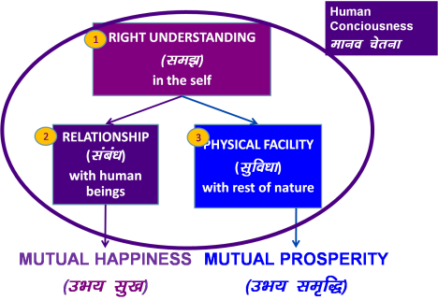
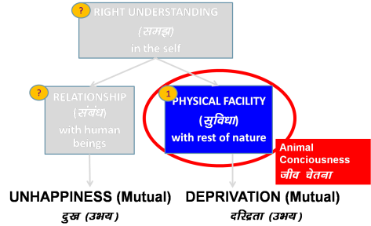
Transformation = Holistic Development
Animals living with Animal Consciousness | They are in Harmony | This is fine
Human being living with Human Consciousness | They are in Harmony | This is fine
Human being living with Animal Consciousness | They are in Disharmony | This is the problem
Transformation & Progress

Slide 57
Course/Workshop Content: Right Understanding
RIGHT UNDERSTANDING
in the self
Understanding Harmony:
Harmony in the Individual
Harmony in Family
Harmony in Society
Harmony in Nature/Existence
1
2
RELATIONSHIP with human beings
PHYSICAL FACILITY
with rest of nature
Living in Harmony at
all 4 levels:
Individual
Family
Society
Nature/Existence
3
Feelings
- Trust
- Respect
- …
MUTUAL HAPPINESS
MUTUAL PROSPERITY

Slide 58
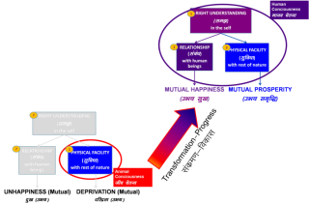
Role of Education-Sanskar: Enable Transformation
Holistic development is transformation to Human Consciousness.
The role of education-sanskar is to enable this transformation by way of ensuring the development of the competence to live with Definite Human Conduct
For this, the education-sanskar has to ensure
Right understanding in the self of every child
The capacity to live in relationship with the other human beings
The capacity to identify the need of physical facility and the skills & practice for sustainable production of more than what is required leading to the feeling of prosperity
These are the 3 components of human eduction-sanskar, if it has to ensure development of definite human conduct
Current State: Are we ensuring 1, 2 and 3 ?

Slide 59
Role of Education-Sanskar: Enable Transformation
If we look at the education we are giving today…
First one is missing
The second one is missing
In the third one, identification of physical facility, is also missing. The willingness to produce by way of labour is also missing. The core feeling that is generated is to accumulate more & more rather than produce more & more ; and to consume more & more
Parents, teachers & society/environment have the
responsibility of providing education-sanskar
We will explore the steps necessary to ensure
Human Education-Sanskar

Slide 60
4. The Basic Human Aspirations – Continuous Happiness and Prosperity

Slide 61
Exploring the meaning of Happiness
Is it something subjective which can’t be defined
OR
Is it something real which can be objectively defined?

Slide 62
Happiness Unhappiness
The state or situation, in which I live,
if there is harmony / synergy in it,
then it is Naturally Acceptable to me to be in that state / situation
To be in a state / situation which is Naturally Acceptable is Happiness
To be in in a state of Harmony / Synergy is Happiness
Happiness = Harmony
The state or situation, in which I live,
if there is disharmony / contradiction in it,
then it is not Naturally Acceptable to me to be in that state / situation
To be forced to be in a state / situation which is not Naturally Acceptable is Unhappiness
To be forced to be in a state of Disharmony / Contradiction is Unhappiness
Unhappiness = Disharmony

Slide 63
Continuity of Happiness
Happiness = To Be in Harmony
Expanse of my Being:
As an Individual
In Family
In Society
In Nature/Existence
Continuity of Happiness = Harmony at all levels of my Being. i.e.
Harmony in the Human Being
Harmony in the Family
Harmony in the Society
Harmony in Nature/Existence

Slide 64
Exploring the Meaning of Prosperity
Prosperity is the feeling of having more than required physical facility.
There are two basic requirements:
Right assessment of the need for physical facility, along with its required quantity
Ensuring the availability/production of more than required physical facility.

Slide 65
Prevailing Notions of Happiness
Continuity of Happiness from Physical facility?
Continuity of happiness from favourable feeling from others?
Happiness is not the same as excitement.
Other Prevailing Notions about Happiness:
Hapiness and unhappiness are the two sides of the same coin
If we become happy progress will stop.
My happiness depends on the others. What can I do about it?
We don't want happiness for ourselves, but we want to make others happy.
Happiness is small thing, I have higher aspirations such as contentment, peace, bliss, etc…

Slide 66
Excitement and Escape
Excitement (Temporary Happiness) from Outside
Escape (running away from unhappiness)
Consumption of Physical Facility, enjoyment of favorable sensations
- (Sound, touch, Form, Taste, Smell)
(Tasty-Necessary) – Tasty-Unnecessary) – (Tasteless-Unnecessary)- (Intolerable)
Receiving favorable feeling from others
- (Attention, Appreciation…)
Temporary Excitement
Over eating
Over Sleeping
---
Gutka/ Tobacco
Alcohol
Drugs
.---
Temporary escape from Unhappiness

Slide 67
A Critical Appraisal of the current Scenario
NOTION OF HAPPINESS
Consumption of Physical Facility, enjoyment of favorable sensations
(Sound, touch, Form, Taste, Smell)
Receiving favorable feeling from others
- (Attention, Appreciation…)
Temporary escape from Unhappiness
NOTION OF PROSPERITY
To be rich is to be Prosperous
Domination and Exploitation
Accumulation of Physical facility
Injustice
Violation of natural Laws
Opposition, Struggle
Injustice Terrorism
War …
Resource depletion Environment Pollution
Climate Change Global Warming

Slide 68
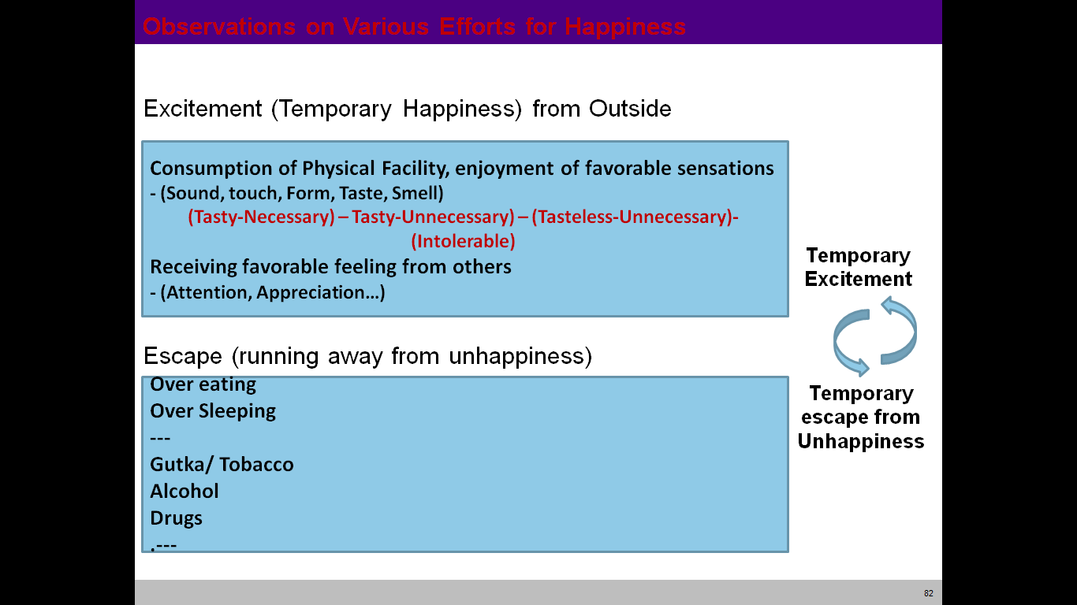
Happiness, Excitement and Escape from Unhappiness
Happiness (Harmony) within
Having the right Understanding within
- i.e. understanding of the harmony at all levels of being
(Human being, Family, Society, Nature/ Existence)
Having the right feeling within
- i.e. like trust, respect, ….. love
Continuous Happiness
Human Consciousness
Animal Consciousness

Slide 69
The Program for Happiness
Right Understanding
Harmony at all levels of being
Human Being, Family, Society, Nature/Existence
2. Right Feeling Trust, Respect, Affection, Care, Guidance,
Reverence, Glory, Gratitude, Love
3. Adequate Physical Facilities

